Slide 1
Queue, Deque, and Priority Queue Implementations
Chapter 11
Data Structures and Abstractions with Java, 4e
Frank Carrano
© 2015 Pearson Education, Inc., Upper Saddle River, NJ. All rights reserved.

Slide 2
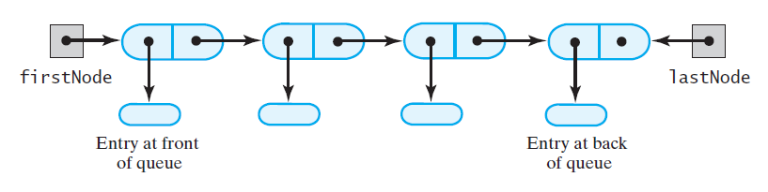
Linked Implementation of a Queue
FIGURE 11-1 A chain of linked nodes
that implements a queue
© 2015 Pearson Education, Inc., Upper Saddle River, NJ. All rights reserved.

Slide 3
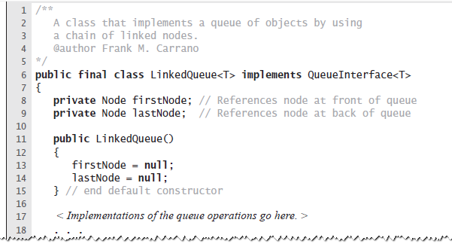
Linked Implementation of a Queue
LISTING 11-1 An outline of a linked implementation
of the ADT queue
© 2015 Pearson Education, Inc., Upper Saddle River, NJ. All rights reserved.

Slide 4
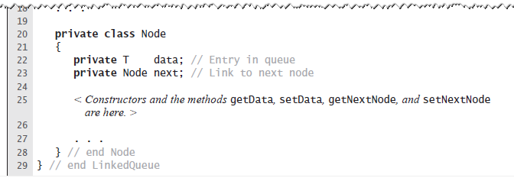
Linked Implementation of a Queue
LISTING 11-1 An outline of a linked implementation
of the ADT queue
© 2015 Pearson Education, Inc., Upper Saddle River, NJ. All rights reserved.

Slide 5
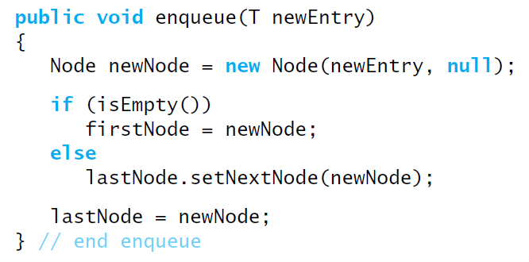
Linked Implementation of a Queue
The definition of enqueue
Performance is O(1)
© 2015 Pearson Education, Inc., Upper Saddle River, NJ. All rights reserved.

Slide 6
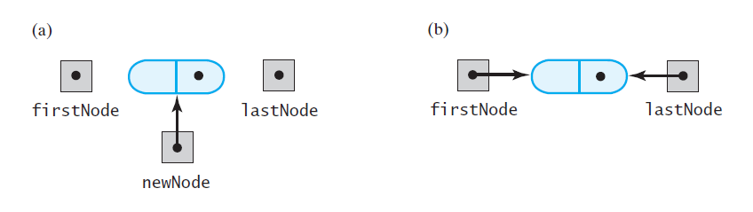
Linked Implementation of a Queue
FIGURE 11-2 (a) Before adding a new node to an empty chain; (b) after adding it
© 2015 Pearson Education, Inc., Upper Saddle River, NJ. All rights reserved.

Slide 7
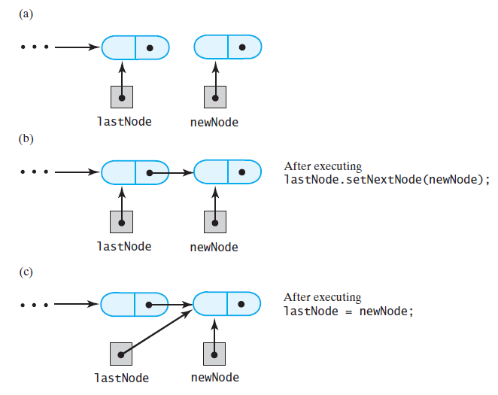
Linked Implementation of a Queue
FIGURE 11-3 (a) Before, and (b) during adding a new node to the end of a nonempty chain that has a tail reference
© 2015 Pearson Education, Inc., Upper Saddle River, NJ. All rights reserved.

Slide 8
Linked Implementation of a Queue
FIGURE 11-3 (c) After adding a new node to the end of a nonempty chain that has a tail reference
© 2015 Pearson Education, Inc., Upper Saddle River, NJ. All rights reserved.

Slide 9
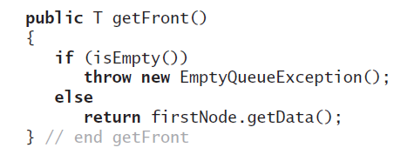
Linked Implementation of a Queue
Retrieving the front entry
© 2015 Pearson Education, Inc., Upper Saddle River, NJ. All rights reserved.

Slide 10
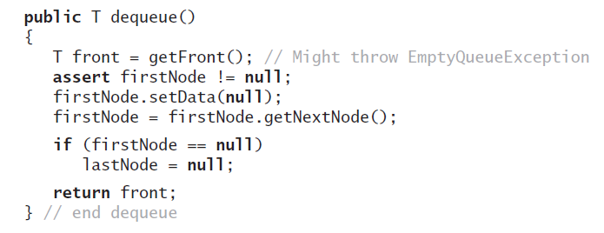
Linked Implementation of a Queue
Removing the front entry
© 2015 Pearson Education, Inc., Upper Saddle River, NJ. All rights reserved.

Slide 11
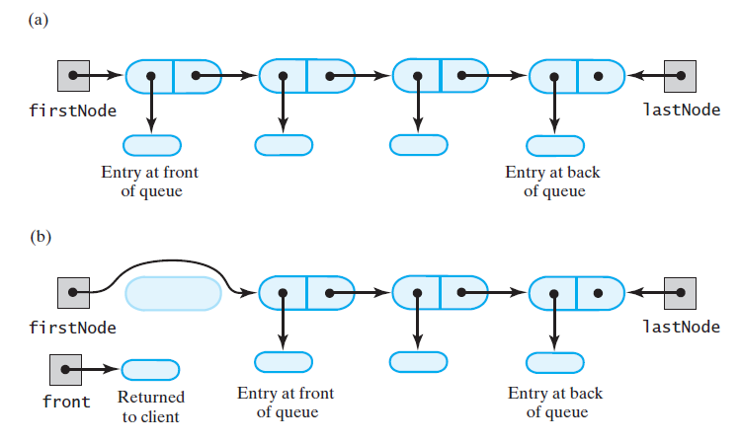
Linked Implementation of a Queue
FIGURE 11-4 (a) A queue of more than one entry; (b) after removing the entry at the front of the queue
© 2015 Pearson Education, Inc., Upper Saddle River, NJ. All rights reserved.

Slide 12
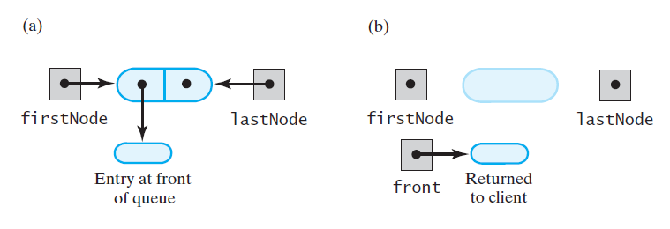
Linked Implementation of a Queue
FIGURE 11-5 (a) A queue of one entry; (b) after removing the entry at the front of the queue
© 2015 Pearson Education, Inc., Upper Saddle River, NJ. All rights reserved.

Slide 13
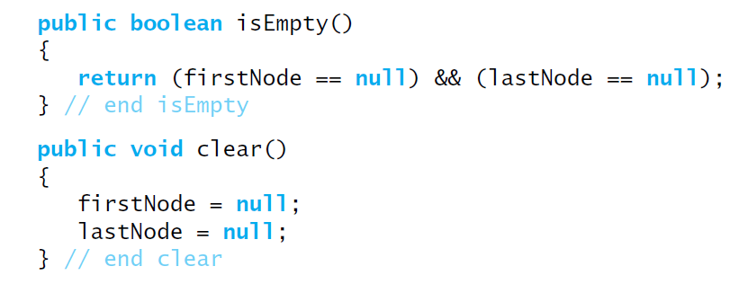
Linked Implementation of a Queue
Public methods isEmpty and clear
© 2015 Pearson Education, Inc., Upper Saddle River, NJ. All rights reserved.

Slide 14
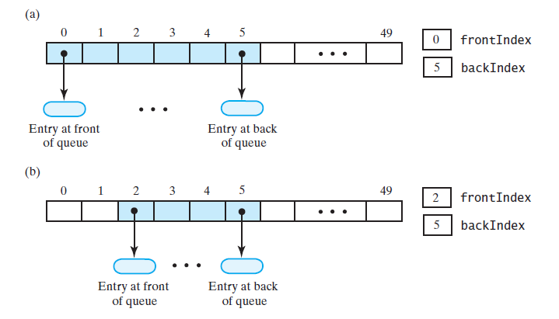
Array-Based Implementation of a Queue: Circular Array
FIGURE 11-6 An array that represents a queue without moving any entries: (a) initially;
(b) after removing the entry at the front twice;
© 2015 Pearson Education, Inc., Upper Saddle River, NJ. All rights reserved.

Slide 15
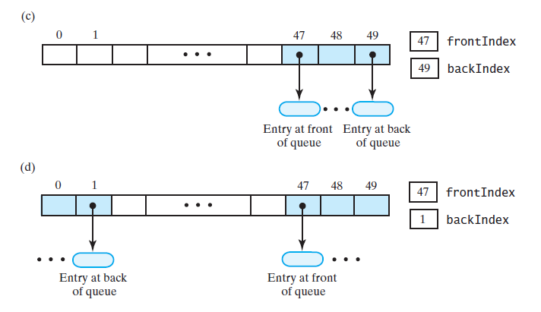
Circular Array
FIGURE 11-6 An array that represents a queue without moving any entries: (c) several more additions, removals; (d) after two additions that wrap around to beginning of array
© 2015 Pearson Education, Inc., Upper Saddle River, NJ. All rights reserved.

Slide 16
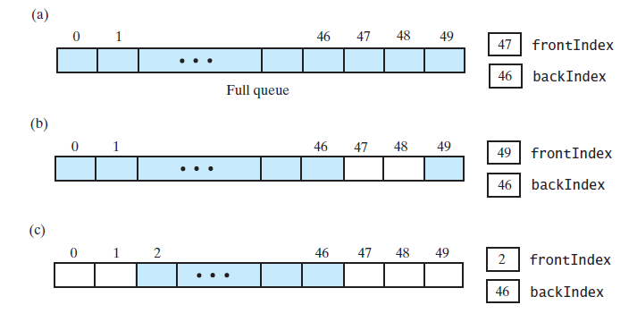
Circular Array
FIGURE 11-7 A circular array that represents a queue:
(a) when full; (b) after removing two entries; (c) after removing three more entries;
© 2015 Pearson Education, Inc., Upper Saddle River, NJ. All rights reserved.

Slide 17
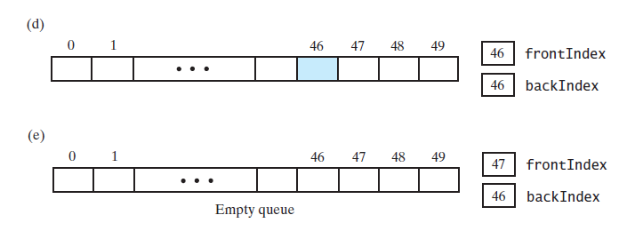
Circular Array
FIGURE 11-7 A circular array that represents a queue:
(d) after removing all but one entry; (e) after removing the remaining entry
© 2015 Pearson Education, Inc., Upper Saddle River, NJ. All rights reserved.

Slide 18
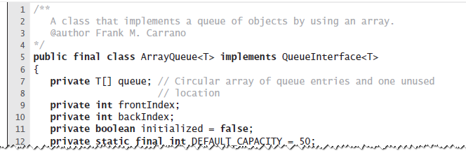
Circular Array with One Unused Location
LISTING 11-2 An outline of an array-based implementation of the ADT queue
© 2015 Pearson Education, Inc., Upper Saddle River, NJ. All rights reserved.

Slide 19
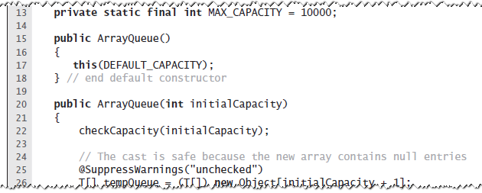
Circular Array with One Unused Location
LISTING 11-2 An outline of an array-based implementation of the ADT queue
© 2015 Pearson Education, Inc., Upper Saddle River, NJ. All rights reserved.

Slide 20
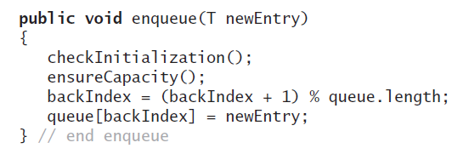
Circular Array with One Unused Location
Adding to the back
© 2015 Pearson Education, Inc., Upper Saddle River, NJ. All rights reserved.

Slide 21
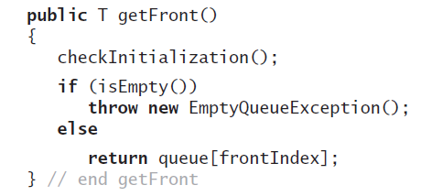
Circular Array with One Unused Location
Retrieving the front entry
© 2015 Pearson Education, Inc., Upper Saddle River, NJ. All rights reserved.

Slide 22
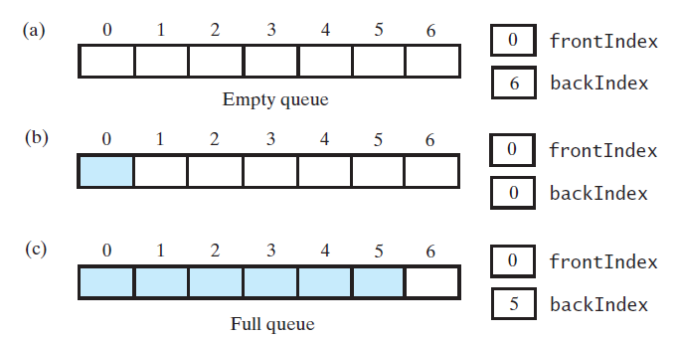
Circular Array with One Unused Location
FIGURE 11-8 A seven-location circular array that contains at most six entries of a queue
© 2015 Pearson Education, Inc., Upper Saddle River, NJ. All rights reserved.

Slide 23
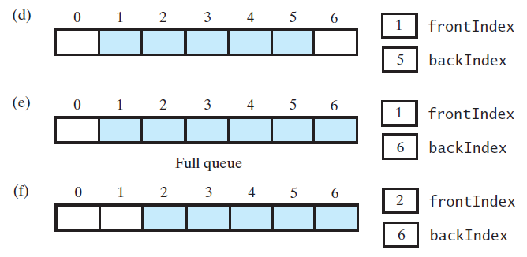
Circular Array with One Unused Location
FIGURE 11-8 A seven-location circular array that contains at most six entries of a queue
© 2015 Pearson Education, Inc., Upper Saddle River, NJ. All rights reserved.

Slide 24
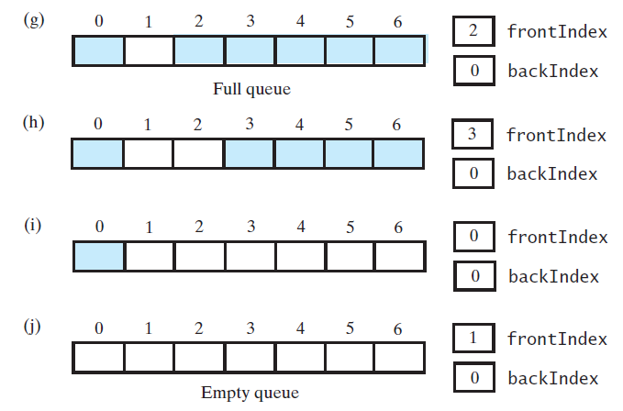
Circular Array with One Unused Location
FIGURE 11-8 A seven-location circular array that contains at most six entries of a queue
© 2015 Pearson Education, Inc., Upper Saddle River, NJ. All rights reserved.

Slide 25
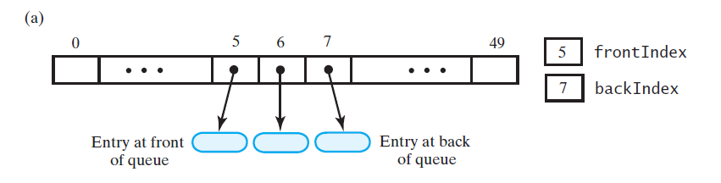
Circular Array with One Unused Location
FIGURE 11-9 An array-based queue: (a) initially;
© 2015 Pearson Education, Inc., Upper Saddle River, NJ. All rights reserved.

Slide 26
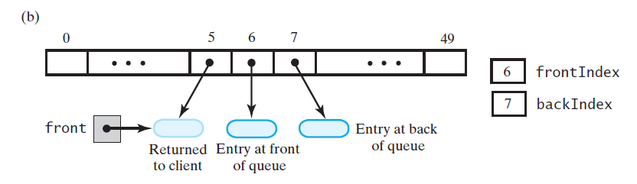
Circular Array with One Unused Location
FIGURE 11-9 An array-based queue: (b) after removing its front entry by incrementing frontIndex;
© 2015 Pearson Education, Inc., Upper Saddle River, NJ. All rights reserved.

Slide 27
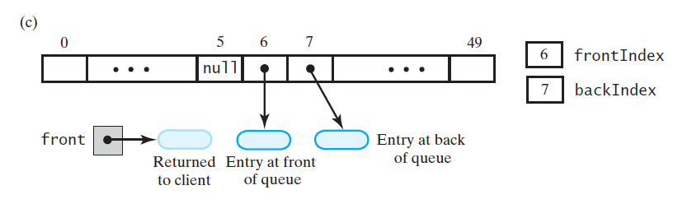
Circular Array with One Unused Location
FIGURE 11-9 An array-based queue: (c) after removing its front entry by setting queue[frontIndex] to null and then incrementing frontIndex
© 2015 Pearson Education, Inc., Upper Saddle River, NJ. All rights reserved.

Slide 28
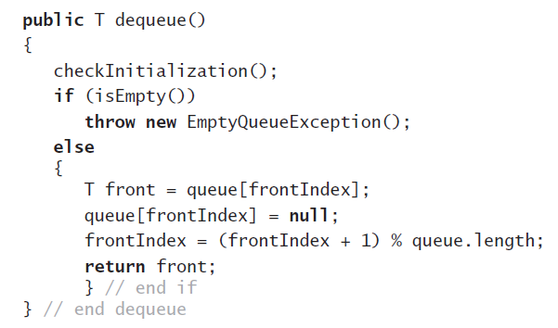
Circular Array with One Unused Location
Implementation of dequeue
© 2015 Pearson Education, Inc., Upper Saddle River, NJ. All rights reserved.

Slide 29
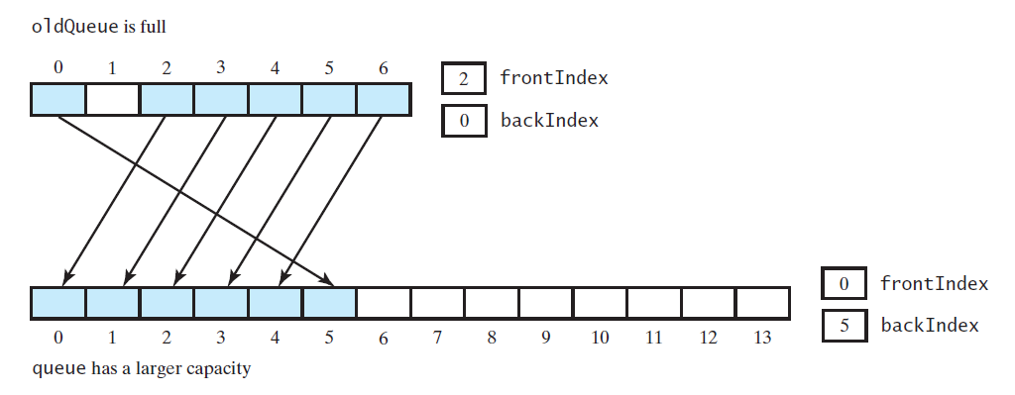
Circular Array with One Unused Location
FIGURE 11-10 Doubling the size of an array-based queue
© 2015 Pearson Education, Inc., Upper Saddle River, NJ. All rights reserved.

Slide 30
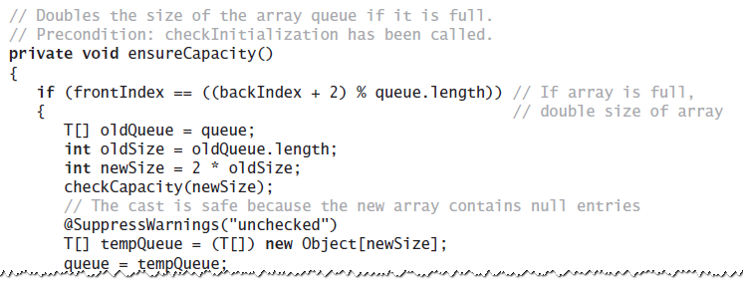
Circular Array with One Unused Location
Definition of ensureCapacity
© 2015 Pearson Education, Inc., Upper Saddle River, NJ. All rights reserved.

Slide 31
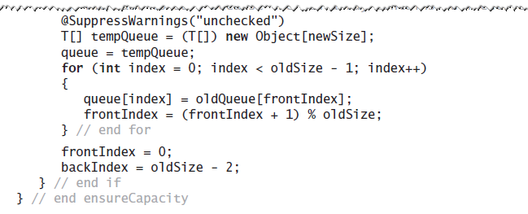
Circular Array with One Unused Location
Definition of ensureCapacity
© 2015 Pearson Education, Inc., Upper Saddle River, NJ. All rights reserved.

Slide 32
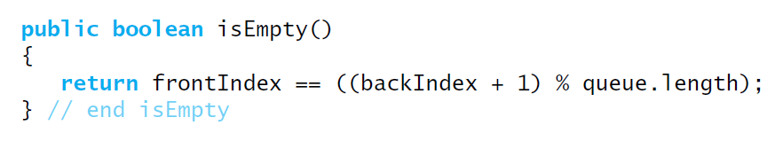
Circular Array with One Unused Location
Implementation of isEmpty
© 2015 Pearson Education, Inc., Upper Saddle River, NJ. All rights reserved.

Slide 33
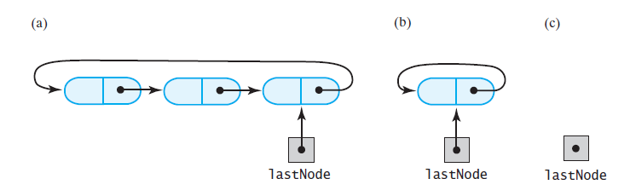
Circular Linked
Implementations of a Queue
FIGURE 11-11 A circular linked chain with an external reference to its last node that (a) has more than one node; (b) has one node; (c) is empty
© 2015 Pearson Education, Inc., Upper Saddle River, NJ. All rights reserved.

Slide 34
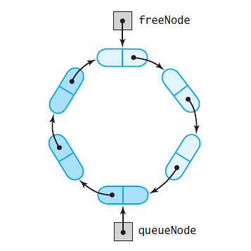
Two-Part Circular Linked Chain
FIGURE 11-12 A two-part circular linked chain that represents both a queue and the nodes available to the queue
© 2015 Pearson Education, Inc., Upper Saddle River, NJ. All rights reserved.

Slide 35
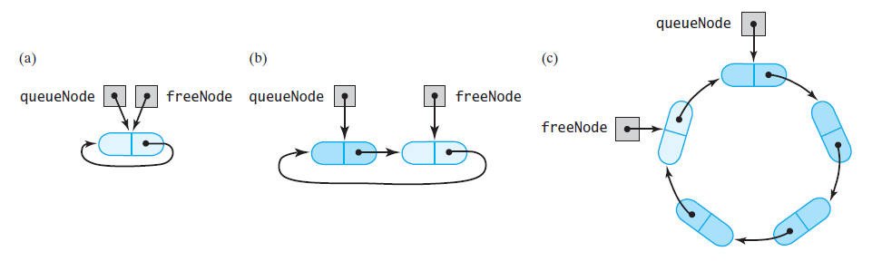
Two-Part Circular Linked Chain
FIGURE 11-14 A two-part circular linked chain that represents a queue: (a) when it is empty; (b) after adding one entry;
(c) after adding three more entries
© 2015 Pearson Education, Inc., Upper Saddle River, NJ. All rights reserved.

Slide 36
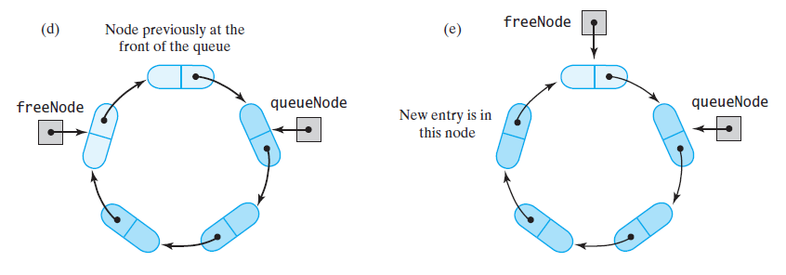
Two-Part Circular Linked Chain
FIGURE 11-14 A two-part circular linked chain that represents a queue: (d) after removing the front entry;
(e) after adding one more entry
© 2015 Pearson Education, Inc., Upper Saddle River, NJ. All rights reserved.

Slide 37
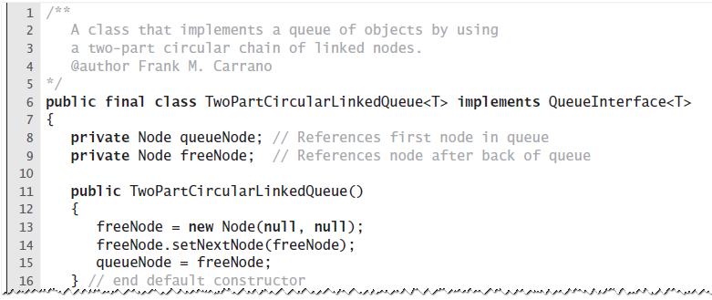
Two-Part Circular Linked Chain
LISTING 11-3 An outline of a two-part circular linked implementation of the ADT queue
© 2015 Pearson Education, Inc., Upper Saddle River, NJ. All rights reserved.

Slide 38
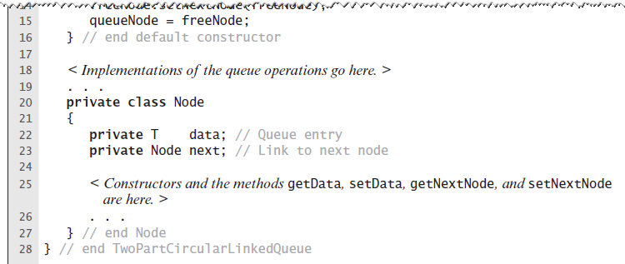
Two-Part Circular Linked Chain
LISTING 11-3 An outline of a two-part circular linked implementation of the ADT queue
© 2015 Pearson Education, Inc., Upper Saddle River, NJ. All rights reserved.

Slide 39
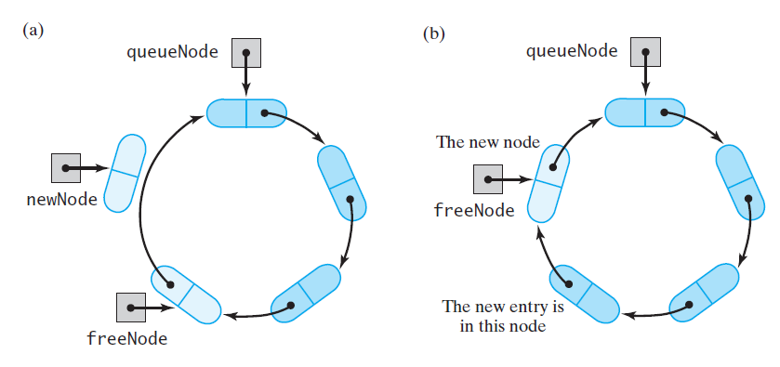
Two-Part Circular Linked Chain
FIGURE 11-14 A chain that requires a new node for an addition to a queue: (a) before the addition; (b) after the addition
© 2015 Pearson Education, Inc., Upper Saddle River, NJ. All rights reserved.

Slide 40
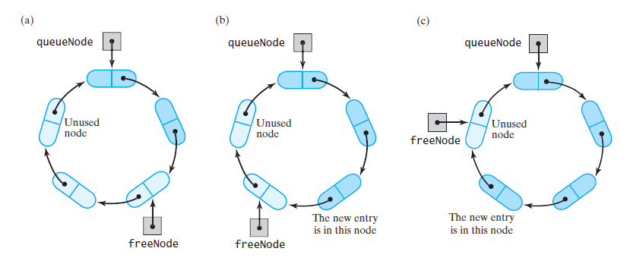
Two-Part Circular Linked Chain
FIGURE 11-15 (a) A chain with nodes available for additions to a queue; (b) the chain after one addition; (c) the chain after another addition
© 2015 Pearson Education, Inc., Upper Saddle River, NJ. All rights reserved.

Slide 41
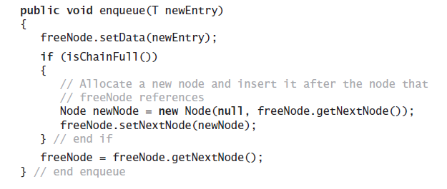
Two-Part Circular Linked Chain
Implementation of enqueue is an O(1) operation
© 2015 Pearson Education, Inc., Upper Saddle River, NJ. All rights reserved.

Slide 42
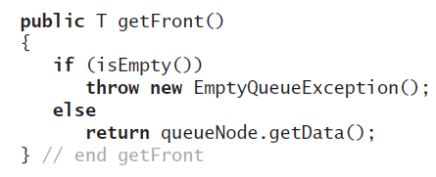
Two-Part Circular Linked Chain
Implementation of getFront is an O(1) operation
© 2015 Pearson Education, Inc., Upper Saddle River, NJ. All rights reserved.

Slide 43
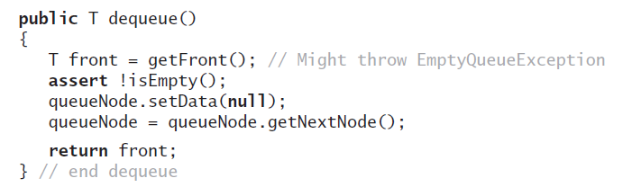
Two-Part Circular Linked Chain
Implementation of dequeue is an O(1) operation
© 2015 Pearson Education, Inc., Upper Saddle River, NJ. All rights reserved.

Slide 44
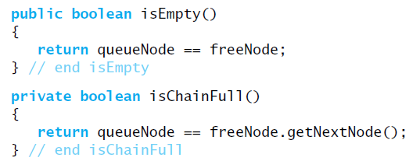
Two-Part Circular Linked Chain
Methods isEmpty an isChainFull
© 2015 Pearson Education, Inc., Upper Saddle River, NJ. All rights reserved.

Slide 45
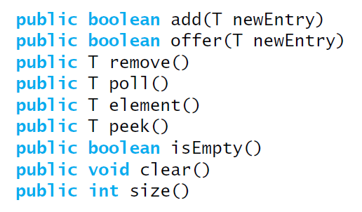
Java Class Library:
The Class AbstractQueue
Methods in this interface
© 2015 Pearson Education, Inc., Upper Saddle River, NJ. All rights reserved.

Slide 46
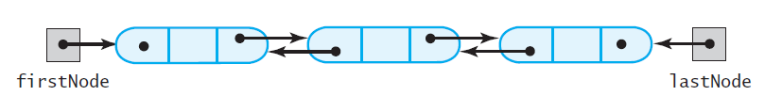
Doubly Linked
Implementation of a Deque
FIGURE 11-16 A doubly linked chain
with head and tail references
© 2015 Pearson Education, Inc., Upper Saddle River, NJ. All rights reserved.

Slide 47
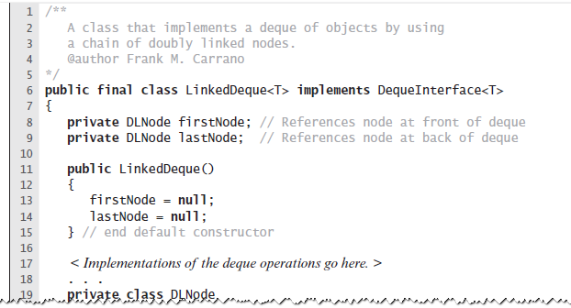
Doubly Linked
Implementation of a Deque
LISTING 11-4 An outline of a linked
implementation of the ADT deque
© 2015 Pearson Education, Inc., Upper Saddle River, NJ. All rights reserved.

Slide 48
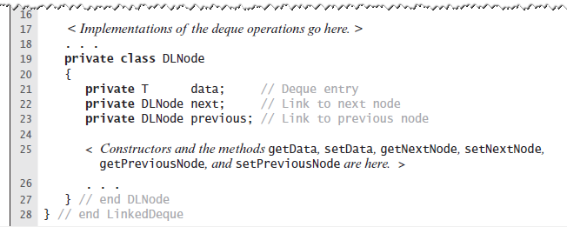
Doubly Linked
Implementation of a Deque
LISTING 11-4 An outline of a linked
implementation of the ADT deque
© 2015 Pearson Education, Inc., Upper Saddle River, NJ. All rights reserved.

Slide 49
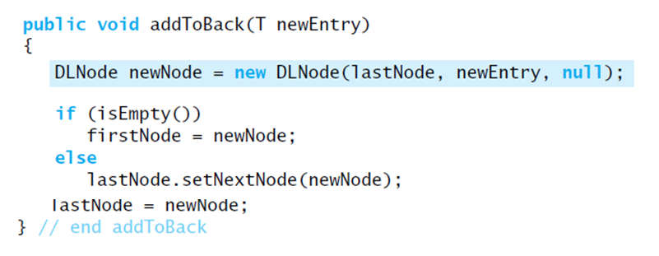
Doubly Linked
Implementation of a Deque
LISTING 11-4 An outline of a linked
implementation of the ADT deque
© 2015 Pearson Education, Inc., Upper Saddle River, NJ. All rights reserved.

Slide 50
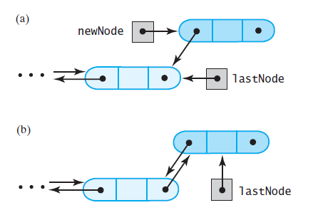
Doubly Linked
Implementation of a Deque
FIGURE 11-17 Adding to the back of a nonempty deque:
(a) after the new node is allocated;
(b) after the addition is complete
© 2015 Pearson Education, Inc., Upper Saddle River, NJ. All rights reserved.

Slide 51
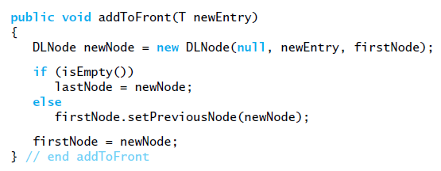
Doubly Linked
Implementation of a Deque
Implementation of addToFront, an O(1) operation.
© 2015 Pearson Education, Inc., Upper Saddle River, NJ. All rights reserved.

Slide 52
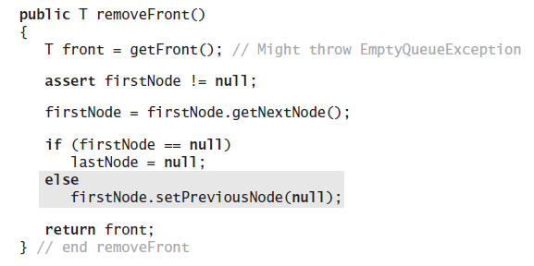
Doubly Linked
Implementation of a Deque
Implementation of removeFront.
© 2015 Pearson Education, Inc., Upper Saddle River, NJ. All rights reserved.

Slide 53

Doubly Linked
Implementation of a Deque
FIGURE 11-18 (a) A deque containing at least two entries; (b) after removing the first node and obtaining a reference to the deque’s new first entry.
© 2015 Pearson Education, Inc., Upper Saddle River, NJ. All rights reserved.

Slide 54

Doubly Linked
Implementation of a Deque
Implementation of removeBack, an O(1) operation.
© 2015 Pearson Education, Inc., Upper Saddle River, NJ. All rights reserved.

Slide 55

Possible Implementations of a Priority Queue
FIGURE 11-19 Two possible implementations of a priority queue using (a) an array; (b) a chain of linked nodes
© 2015 Pearson Education, Inc., Upper Saddle River, NJ. All rights reserved.

Slide 56
End
Chapter 11
© 2015 Pearson Education, Inc., Upper Saddle River, NJ. All rights reserved.

